Slide 1

Enhancing On-Shelf Availability An AI-Driven Approach to Retail Inventory Management
Project Presentation - CIS 731
Ana Guanes
December 12, 2024

Slide 2
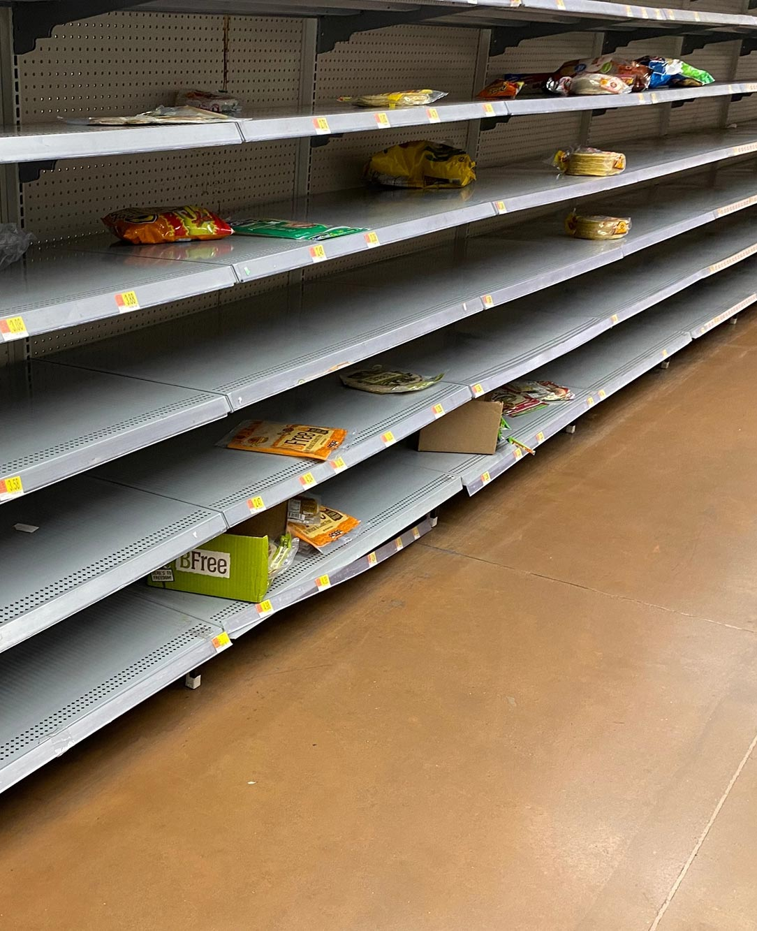
Introduction
Background
Out-of-stock (OOS) events pose a significant challenge for retailers, leading to lost sales, reduced customer satisfaction, and operational inefficiencies.
Effective management of on-shelf availability (OSA) is critical to maintaining a competitive edge in today’s dynamic retail environment.

Slide 3

Introduction
Project Focus
This project leverages AI-driven analytics to improve OSA by predicting demand fluctuations and addressing OOS events proactively.
Using pre-existing data from the Databricks On-Shelf Availability Solution Accelerator, we explored forecasting techniques, evaluated predictions, and provided actionable insights through visualizations.

Slide 4
Objectives
Leverage time-series forecasting techniques to generate demand predictions.
Evaluate the accuracy and reliability of predictions using key metrics (MSE, Accuracy, Precision, and Recall).
Visualize trends and anomalies to provide actionable insights for inventory management.

Slide 5
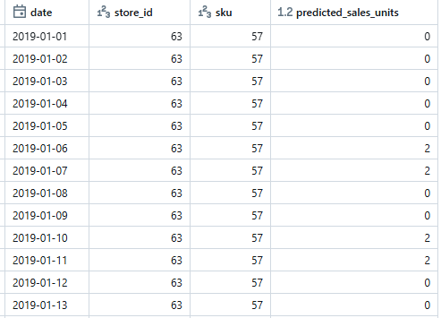
Dataset
Source
The dataset was sourced from the Databricks On-Shelf Availability Solution Accelerator.
Components:
OSA Raw Data: Contains historical sales data, inventory levels, and stock status across multiple store-SKU combinations.
Vendor Lead Time Data: Provides insights into supplier delivery times, enabling analysis of supply chain efficiency.
Key Features:
Dates, store IDs, SKUs, sales units, replenishment flags, and lead times.
Predicted sales (predicted_sales_units) generated using Simple Exponential Smoothing (SES).

Slide 6

Methodology overview
The project followed a structured approach to analyze and improve on-shelf availability (OSA)
Key Steps:
Data Preparation: Cleaned, transformed, and structured raw data into Delta tables for downstream analysis.
Forecasting: Implemented Simple Exponential Smoothing (SES) to generate demand predictions for each store-SKU combination.
Evaluation: Assessed forecast accuracy using metrics such as Mean Squared Error (MSE), Accuracy, Precision, and Recall.
Visualization: Created graphs and charts to identify trends, detect anomalies, and communicate findings effectively.

Slide 7
Data preparation
The data preparation phase focused on cleaning, organizing, and structuring raw datasets for analysis.
Key Steps:
Data Cleaning: Removed duplicates and handled missing values to ensure data consistency.
Data Transformation: Aggregated sales and inventory data by store-SKU combinations and processed lead time information.
Outcome:
Prepared datasets formed the foundation for forecasting and visualization tasks.
raw data
cleaning
Delta table

Slide 8

Forecasting method
Simple Exponential Smoothing (SES) was used to forecast sales for each store-SKU combination, focusing on historical data.
Implementation:
Forecasts were generated for historical sales, predicting daily sales units (predicted_sales_units) for each combination.
Results were saved in the inventory_forecast Delta table for further analysis.

Slide 9
Evaluation metrics
Purpose:
To assess the accuracy and reliability of the forecasting model in predicting out-of-stock (OOS) events.
Key Metrics:
Mean Squared Error (MSE): Measures the average squared difference between actual and predicted sales.
Result: 68.70, indicating a reasonable level of error.
Accuracy: Percentage of correct OOS classifications.
Result: 83.16%.
Precision: Proportion of correctly predicted OOS events out of all predicted OOS events.
Result: 89.96%.
Recall: Proportion of actual OOS events correctly identified by the model.
Result: 90.39%.

Slide 10
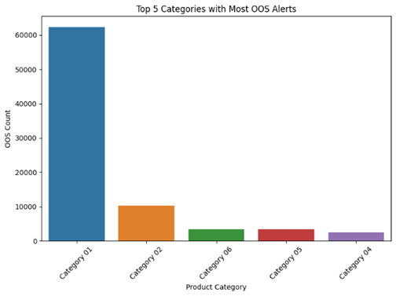
Visualization Insights
Out-of-Stock Alerts by Product Category
shows the top five product categories with the highest OOS occurrences.
Category 1 experiences the most OOS events, followed by Category 2 and Category 3, indicating areas requiring priority focus.

Slide 11
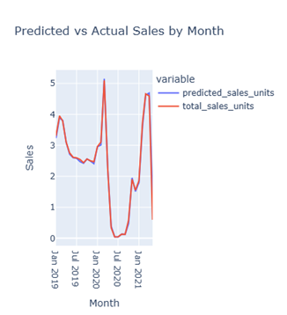
Visualization Insights
Predicted vs. Actual Sales
Compares predicted sales with actual sales over time.
The model closely follows overall trends, with minor deviations in specific months, highlighting potential opportunities for improvement.

Slide 12
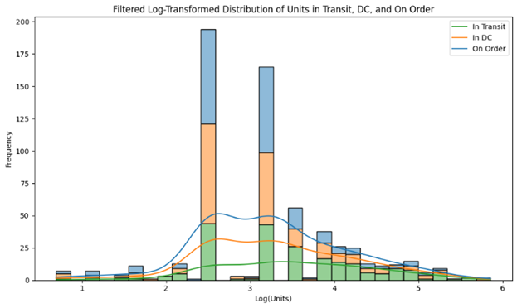
Visualization Insights
Inventory Lead Time Distribution
visualizes the distribution of units in transit, in DC (distribution center), and on order.
Most units fall within predictable ranges, but some outliers indicate potential supply chain inefficiencies.

Slide 13
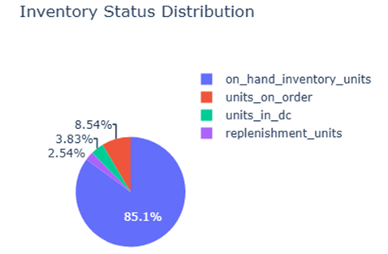
Visualization Insights
Inventory Status Breakdown
Illustrates the proportional breakdown of inventory statuses.
On-hand inventory makes up the largest share, reflecting stable stock availability, while replenishment units highlight active stock updates

Slide 14
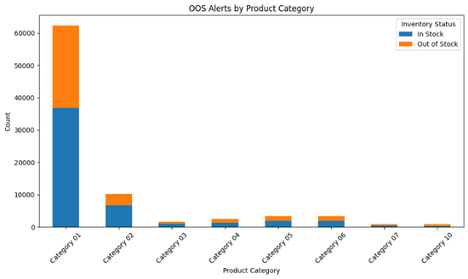
Visualization Insights
Out-of-Stock Alerts by Product Category and Status
shows OOS alerts categorized by inventory status.
Category 1 consistently shows the highest number of OOS alerts across statuses, emphasizing the need for better stock management in this category.

Slide 15
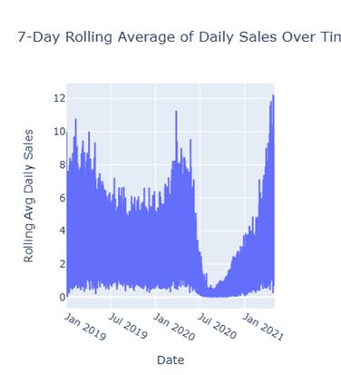
Visualization Insights
Rolling Average of Daily Sales
displays the 7-day rolling average of daily sales.
The visualization highlights seasonal sales patterns, with clear spikes during high-demand periods (holidays) and low demand periods (covid).

Slide 16
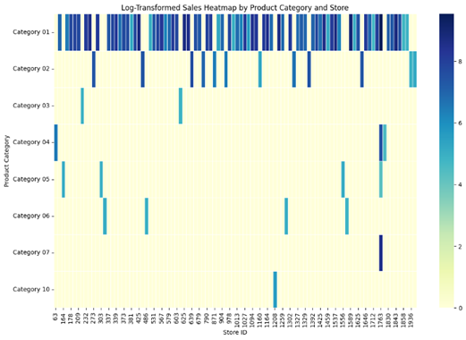
Visualization Insights
Sales Heatmap by Product Category and Store
visualizes sales intensity across product categories and stores.
The darkest regions represent the highest-performing combinations, while lighter areas suggest opportunities for targeted interventions to boost sales.

Slide 17
Results Summary
Key Takeaways:
Improved Demand Predictions:
The Simple Exponential Smoothing (SES) model effectively forecasted sales trends, enabling the identification of potential OOS events.
Insights into Inventory Challenges:
Visualization of inventory trends revealed critical vulnerabilities in specific product categories and stores, aiding in prioritizing replenishment efforts.
Evaluation Metrics:
The forecasts achieved an MSE of 68.70, with 83.16% Accuracy, 89.96% Precision, and 90.39% Recall, demonstrating reasonable model performance.

Slide 18
Conclusion
Summary:
This project leveraged AI-driven analytics to improve on-shelf availability (OSA) by predicting demand and identifying out-of-stock (OOS) events.
Simple Exponential Smoothing (SES) provided reliable forecasts, with Precision (89.96%) and Recall (90.39%).

Slide 19
Reflection and Future Work
Most Challenging Aspect:
Preparing and structuring the data for effective visualizations, ensuring insights were clear and actionable.
Aspect of Most Learning:
Gained deeper insights into time-series forecasting techniques, particularly Simple Exponential Smoothing (SES), and its practical application in inventory management.
Future Work:
Incorporate advanced models like XGBoost and external factors (e.g., promotions) to enhance accuracy.

